Slide 1
Object Tracking Using Computer Vision
Group 3

Slide 2
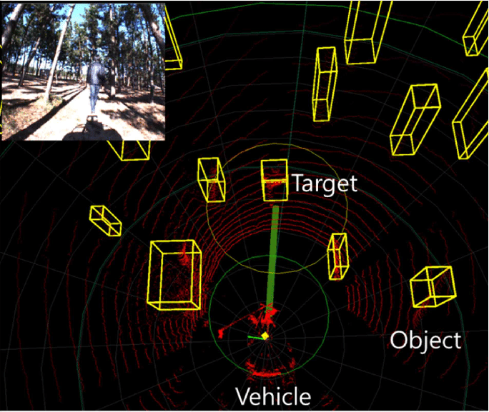
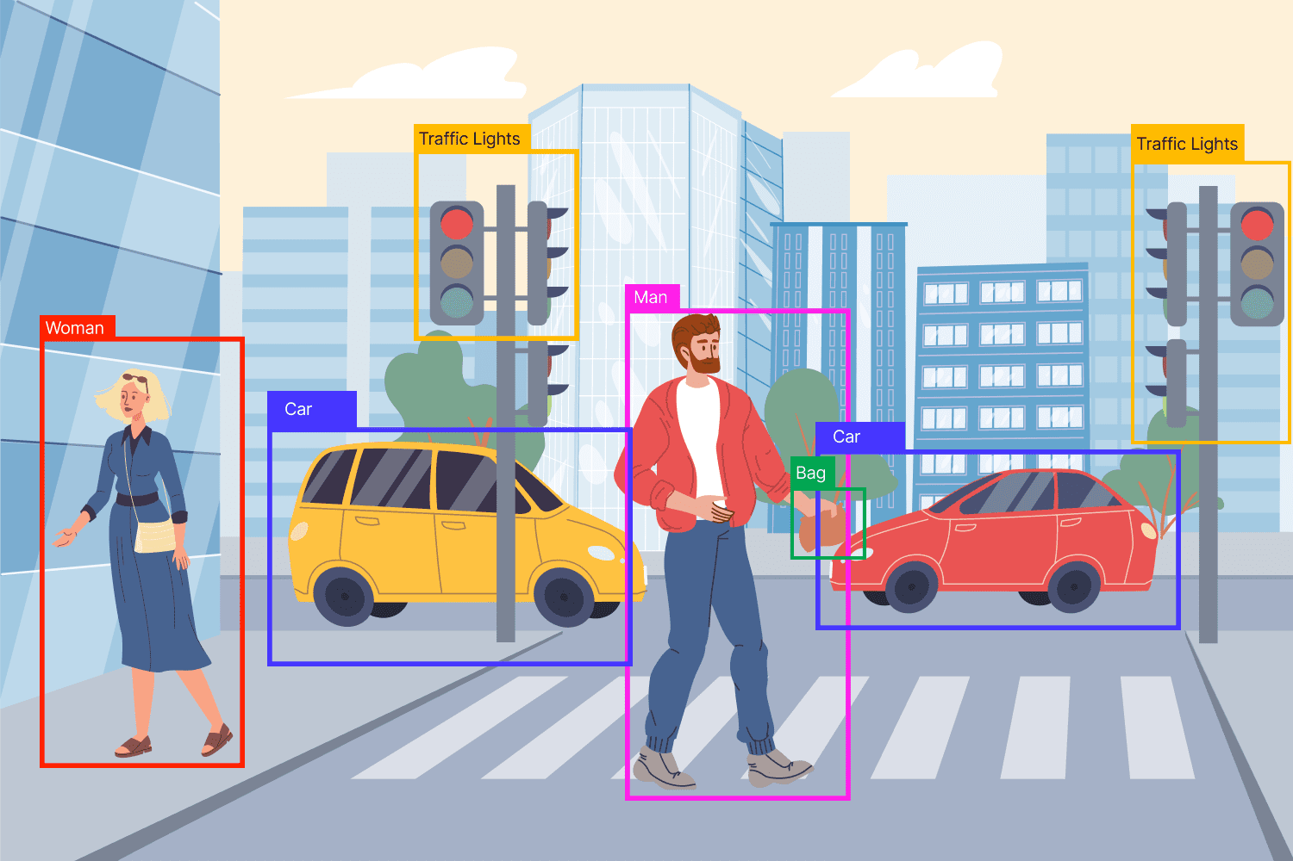
Introduction
Object Tracking is a core problem in computer vision,
Object tracking is vital for fields such as
Robotics: Enabling autonomous robots to perceive and interact with their surroundings.
Autonomous Driving: Crucial for real-time tracking of vehicles, pedestrians, and obstacles.
Pedestrian Movement: Used in surveillance and smart city applications to track human movement for safety and traffic management.
Ensures that machines can adapt to dynamic environments by detecting and following objects of interest.

Slide 3
Technological Advancements:
Camera Hardware: Significant advancements, including the fusion of multiple sensors (e.g., LIDAR, RGB, thermal cameras), enhance tracking accuracy across different environments and conditions.
Image Processing Algorithms: Algorithms have evolved to be faster and more precise, enabling real-time tracking in diverse applications.
Deep Learning Progress: In the last decade, deep learning models such as convolutional neural networks (CNNs) and recurrent neural networks (RNNs) have revolutionized object tracking by learning from large datasets.
Data Association Methods: Techniques like Kalman filtering, Hungarian algorithms, and optical flow are increasingly used in conjunction with deep learning for tracking multiple objects in cluttered scenes.

Slide 4
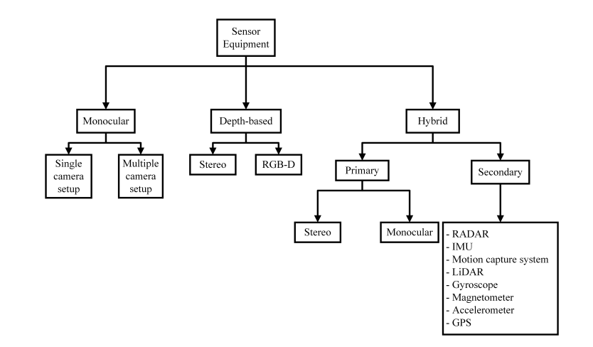
Sensor Equipments

Slide 5
Sensor Equipment Ctd.
• Sensor equipment plays a crucial role in object tracking.
• Vision sensors, such as monocular, depth-based, and hybrid sensors, are used based on application needs.
• Choice of sensors depends on requirements for depth estimation, tracking, or intercepting moving objects.

Slide 6
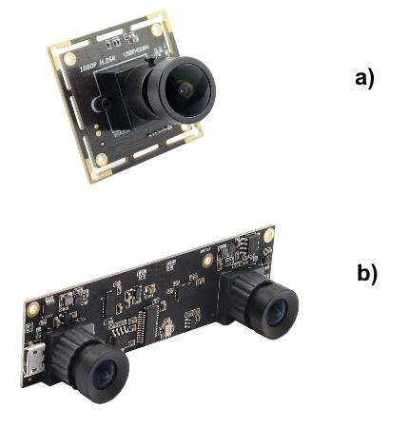
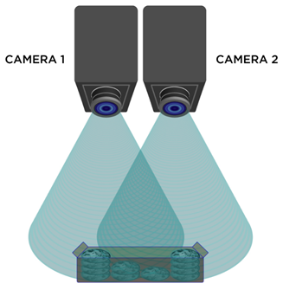
Types of Sensor Equipment
Monocular Cameras:
Single camera providing 2D information, hard to estimate depth.
Example: Missile interception by Kwon et al.
Stereo Cameras:
Two or more cameras, capturing images with depth information.
Suitable for applications needing accurate depth measurements.
Example: Bumblebee2 stereo camera for marine vehicles.

Slide 7
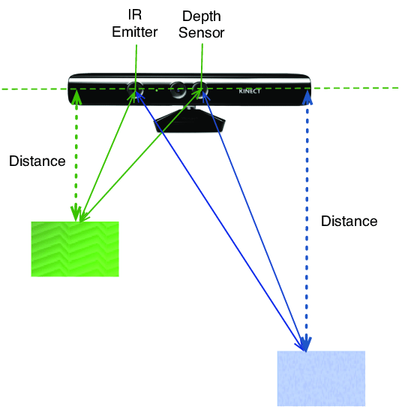
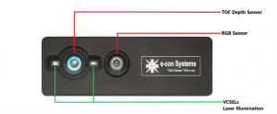
Depth-based and Hybrid Sensors
Depth-based Cameras (RGB-D):
Combine RGB images with depth information.
Ideal for indoor applications requiring precise depth data.
Example: Microsoft Kinect for indoor tracking.

Slide 8
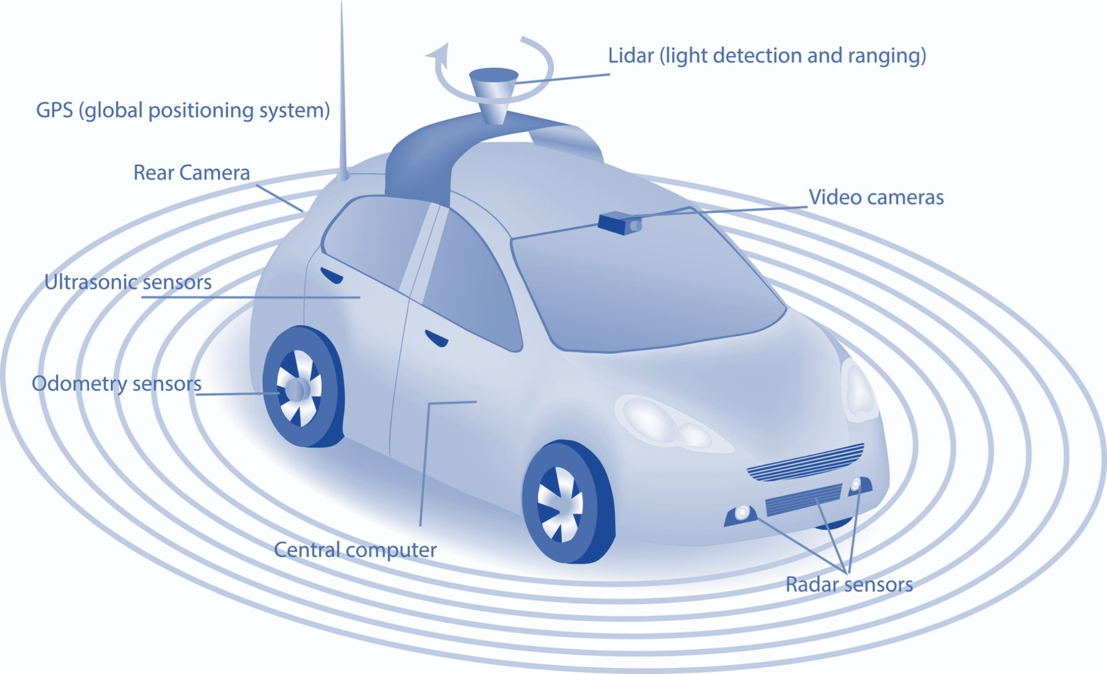
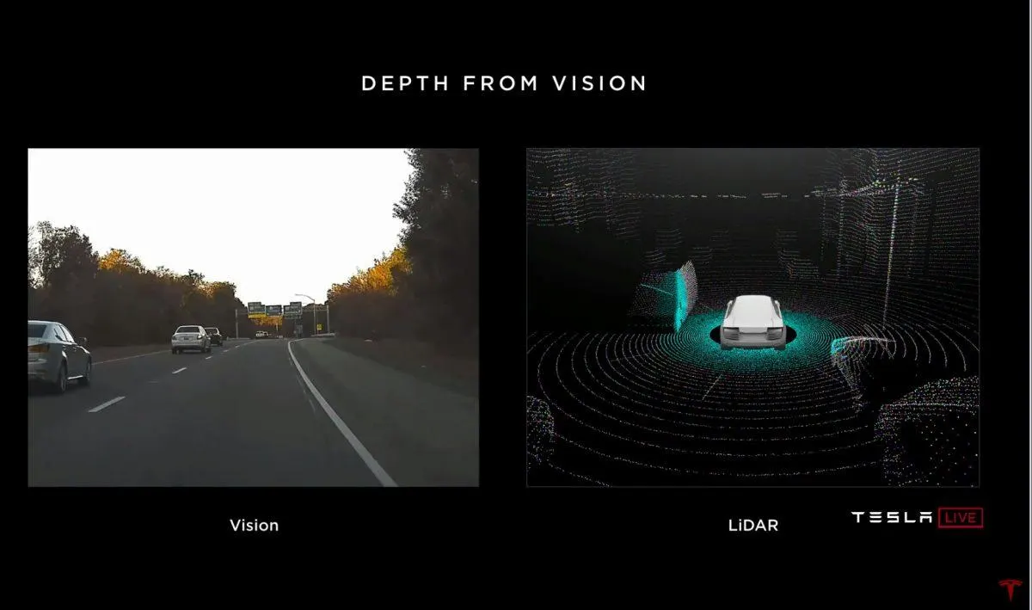
Hybrid Sensors
Combine vision sensors with LiDAR or IMU for dynamic environments.
Commonly used in autonomous vehicle tracking.
Example: Camera with radar for vehicle tracking in urban settings.

Slide 9
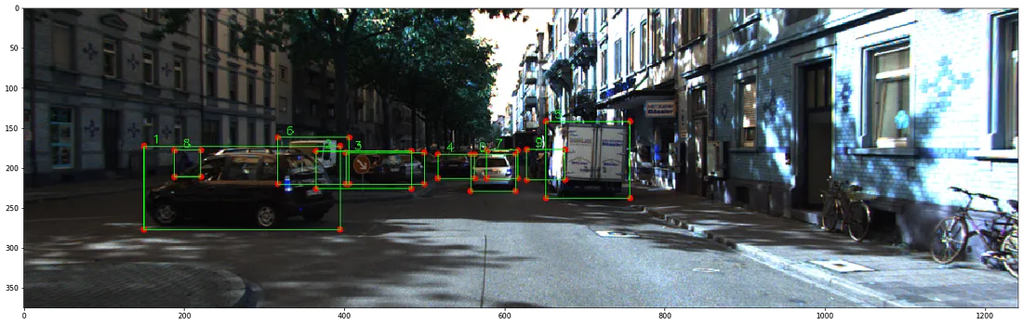
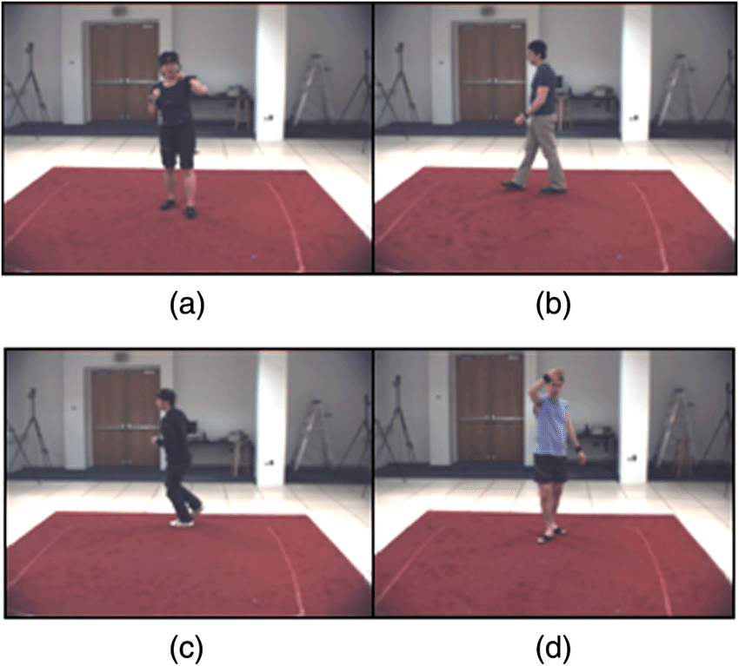
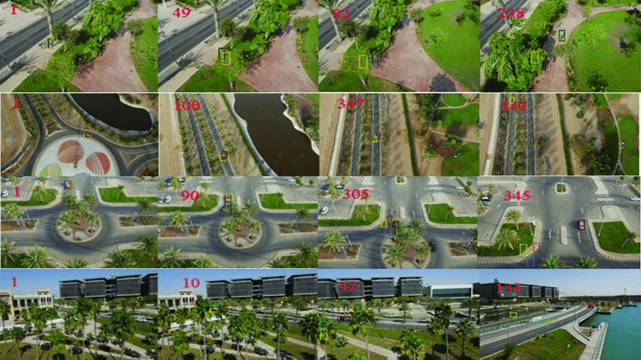
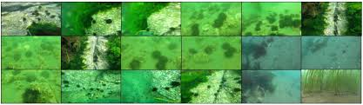
Types of Datasets
Datasets
KITTI Dataset Sample
General Datasets
HumanEVA, VOT, MOT Datasets.
Available for benchmarking and research.
In-house Datasets
Developed by researchers for specific applications.
Useful when public datasets don’t meet specific needs.
HumanEVA Dataset Sample
VOT Dataset Sample
Underwater object detection dataset sample ( In-house dataset)

Slide 10
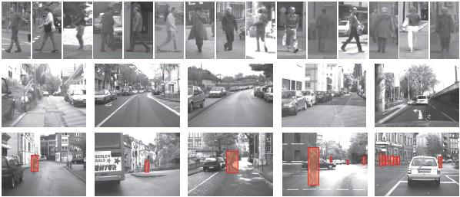
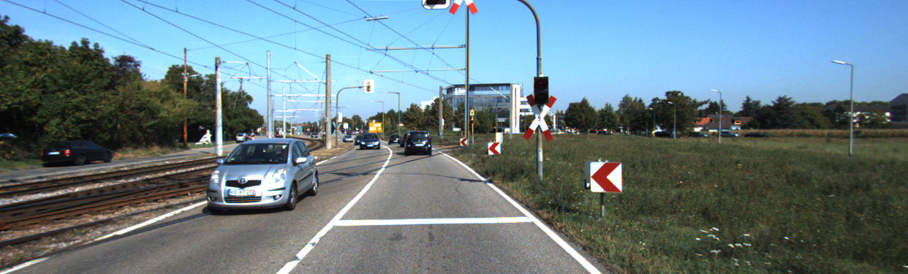
Application-Specific Datasets
Datasets
Autonomous Vehicles:
KITTI Dataset:
Consists of stereo images, laser scans, GPS, IMU data.
Covers tasks such as object detection, road tracking, and depth perception.
Widely used for benchmarking autonomous driving models.
DAIMLER Dataset:
Focuses on pedestrian detection for driving assistance systems.
KITTI Dataset Sample
DAIMLER Dataset Sample

Slide 11
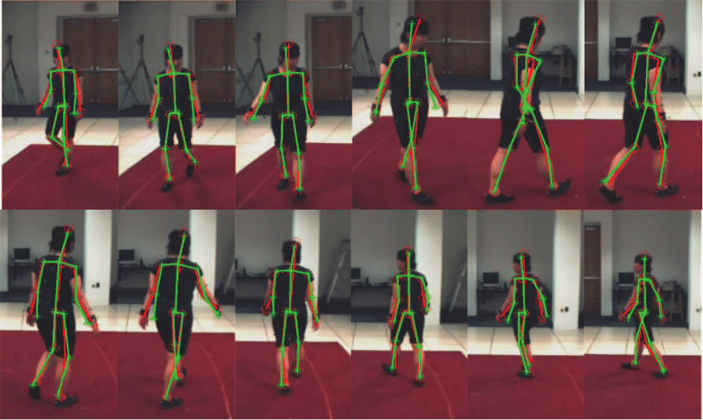
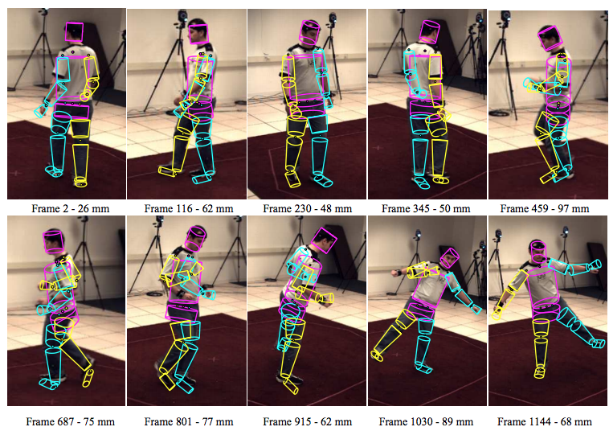
Application-Specific Datasets
Datasets
Medical Purpose:
HumanEVA Dataset:
Provides multi-view human motion tracking for pose estimation.
Includes synchronized motion capture data, useful for biomechanics and medical diagnosis.

Slide 12
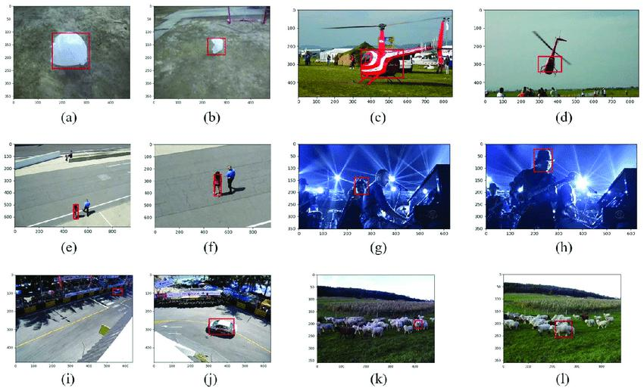
Single-Object Tracking vs Multiple-Object Tracking
Datasets
SOT (Single-Object Tracking):
SOT datasets are mainly focused on tracking a single object in simple, constrained environments.
VOT (Visual Object Tracking) Dataset:
Features video sequences for benchmarking short-term and long-term single-object tracking.
Different versions (VOT2013 to VOT2022)

Slide 13
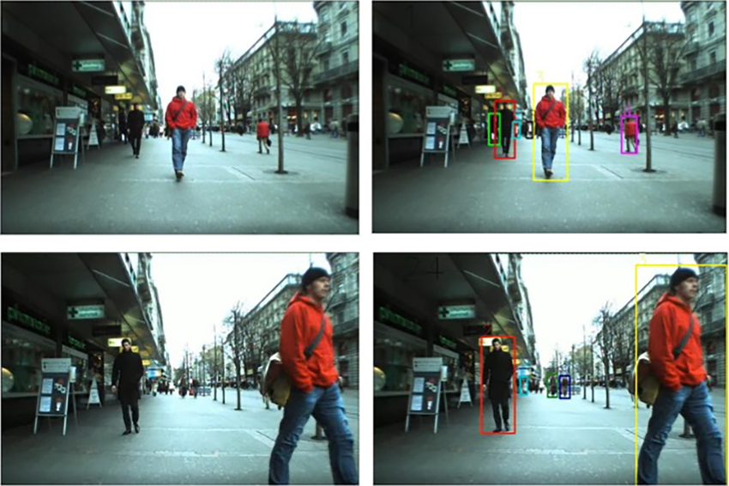
Single-Object Tracking vs Multiple-Object Tracking
Datasets
MOT (Multiple-Object Tracking):
MOT datasets are mainly focused on tracking multiple objects in crowded, real-world scenarios.
MOTChallenge:
A benchmark dataset focusing on pedestrian tracking in urban environments.
Versions include MOT15, MOT16, MOT17, and MOT20.

Slide 14
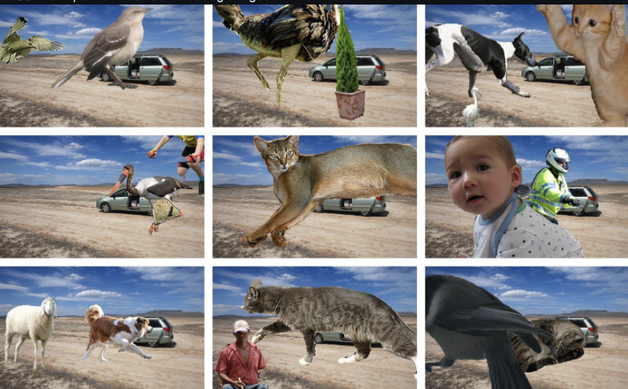
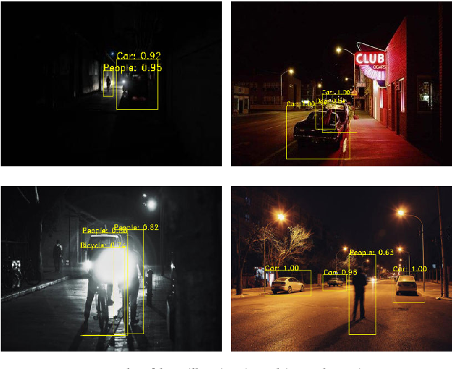
Challenges with Current Datasets
Datasets
Datasets lack diversity in complex environments.
Need for improved datasets that account for:
Occlusions (objects getting blocked from view).
Changing lighting conditions.

Slide 15
Object Tracking Methods
Computer vision problem have been two main approaches as classical image processing or with deep learning techniques
As for the Object Tracking problem we can take mainly two steps as
- detecting the interested object
- tracking over a sequence of images
The tracking can be performed only when the input is a sequence where the object is within the image frame.This partially disappear has created a class of problems called occlusion

Slide 16
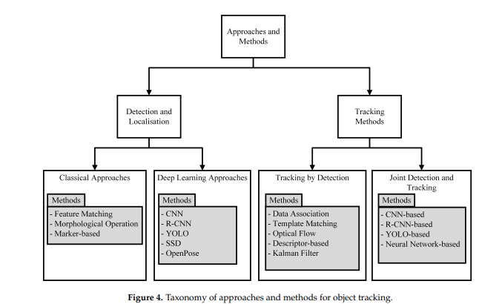

Slide 17
Detection and Localization methods
Classical Approach
Classical image processing uses tailored methods with empirically chosen parameters like kernel size and threshold values.
Detection approaches are commonly categorized into feature matching, morphological operations, and marker-based techniques.

Slide 18
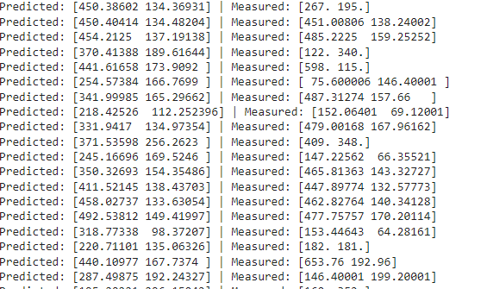
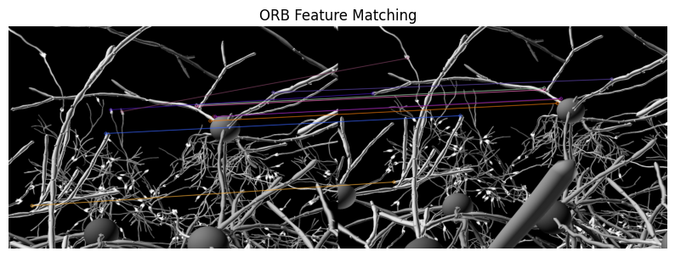
Classical Approach
Using Feature Matching
With Kalman filter

Slide 19
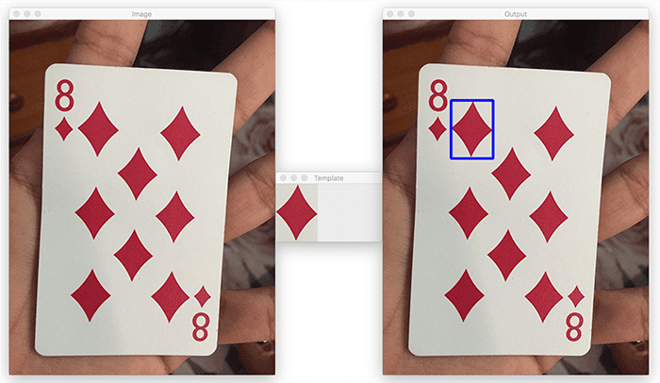
template matching ,

Slide 20
Morphological operations
- Common operations include dilation, erosion, opening, and closing.
- Used to remove noise, fill gaps, or enhance object structures for accurate tracking.
Marker Based
- The system detects the marker and uses it as a reference point for tracking.
- Commonly used in AR

Slide 21
Detection and Localization methods
Deep Learning Approaches
CNNs (Convolutional Neural Networks) are the primary deep learning method used to extract features for object tracking.
Deep learning methods can localize and classify objects in image frames, which enhances the detection stage in object tracking.
Popular methods like YOLO, Faster R-CNN, and SSD are commonly used for real-time object detection and tracking.

Slide 22
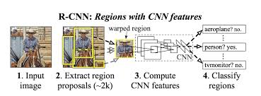
Deep Learning Approach
R -CNN method
- Detects objects by region proposal, using selective search to find potential objects
https://blog.roboflow.com/what-is-r-cnn/

Slide 23
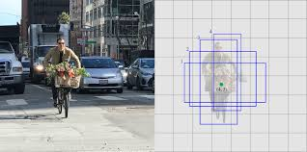
Single -shot detection method
Detects objects and localizes them in a single forward pass.
https://jonathan-hui.medium.com/ssd-object-detection-single-shot-multibox-detector-for-real-time-processing-9bd8deac0e06

Slide 24
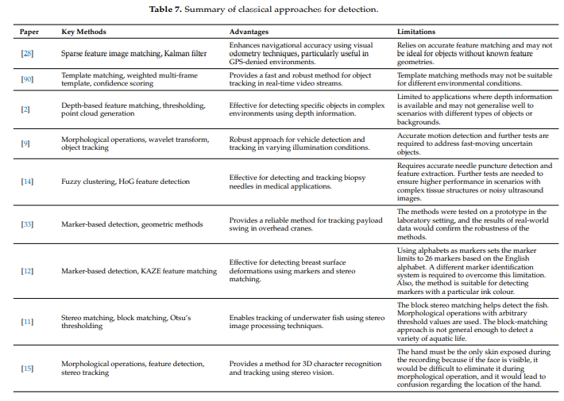

Slide 25
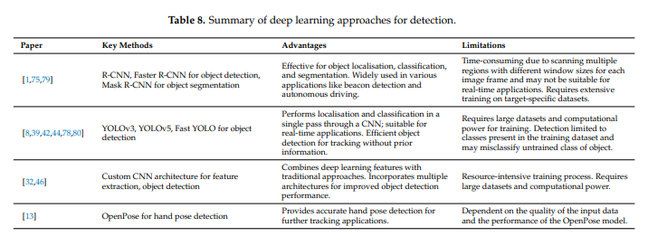

Slide 26
Tracking Methods
Tracking by Detection
TBD methods detect objects in each frame independently, with no prior estimation of future object states.
After detection, the current object is associated with previous detections to maintain tracking across frames.
This approach is widely used in real-time tracking, especially in environments where prior knowledge of the object's movement is unavailable.

Slide 27
Tracking By Detection
Data association - Matches detected objects between consecutive frames using features like position and appearance.
Template matching - Tracks objects by comparing a predefined template image with the current frame.
Optical flow - Tracks object movement by measuring pixel displacement between frames.
Descriptor based - Uses object descriptors (e.g., SIFT, SURF) to match and track objects.
Kalman filter - Predicts the object's next position based on previous observations, useful for linear motion tracking.
KLT Tracker (Kanade-Lucas-Tomasi): Detects and tracks feature points across frames, often used for tracking small object features.

Slide 28
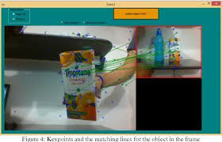
SIFT
https://www.semanticscholar.org/paper/Robust-Object-Detection-and-Tracking-Using-Sift-Yakkali-Nara/b4210c1948847487704178a99d301560a57855b4

Slide 29
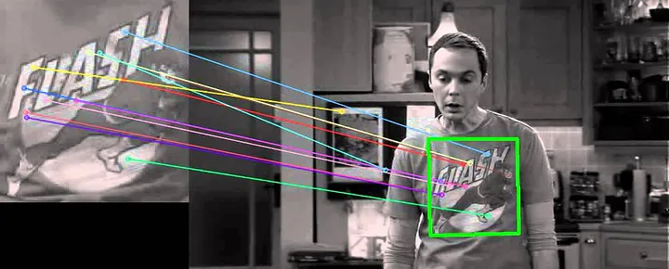
SURF
https://medium.com/@deepanshut041/introduction-to-surf-speeded-up-robust-features-c7396d6e7c4e

Slide 30
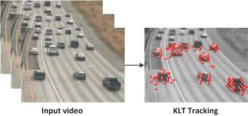
KLT Tracker
https://www.behance.net/gallery/6121361/KLT-Tracking/modules/47710091

Slide 31
Joint Detection and tracking
CNN based approaches
Convolutional Neural Networks (CNNs): Extracts spatial hierarchies and features from images.
R-CNN based approaches
Region-based CNN (R-CNN): Detects objects by region proposal, using selective search to find potential objects.
YOLO and other neural network based approaches
You Only Look Once (YOLO): Real-time object detection by predicting class probabilities and bounding boxes.

Slide 32
Deep SORT (Simple Online and Realtime Tracking) - Tracks multiple objects using a combination of Kalman filtering and deep appearance features.
Siamese Networks - Uses twin networks to learn similarity metrics for object tracking. Popular in real-time tracking applications (e.g., SiamFC and SiamRPN)..
MDNet (Multi-Domain Network) - Uses a CNN-based approach to learn from multiple domains for accurate tracking in complex environments.

Slide 33
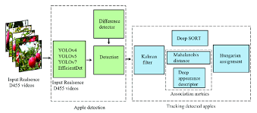
Deep SORT
https://www.researchgate.net/figure/Architecture-of-the-Deep-SORT-algorithm-for-tracking-detected-apples-Architecture-of_fig2_369884480

Slide 34
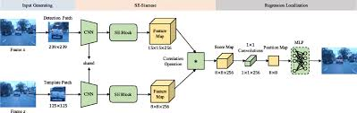
Siamese Networks
https://link.springer.com/article/10.1007/s11042-023-14519-6

Slide 35
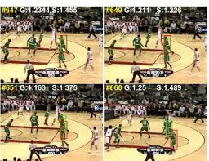
MDNet (Multi-Domain Network)
deep learning framework designed for object tracking across various domains. It leverages a multi-domain learning approach, which allows the model to generalize better to different object appearances and variations,

Slide 36
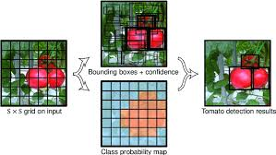
YOLO
https://www.researchgate.net/figure/YOLO-model-detection_fig1_340541009

Slide 37
Recent Advance methods and Hybrid Methods
Correlation Filter Networks - Enhances traditional correlation filters using deep features for robust tracking.
Deep Kalman Filters - Combines Kalman filters with deep neural networks for object tracking in noisy or partially visible scenarios.
Deep Reinforcement Learning - Adapts reinforcement learning algorithms to track objects based on real-time feedback from the environment.
Attention Mechanisms - Used to selectively focus on important regions of the image for more precise tracking

Slide 38
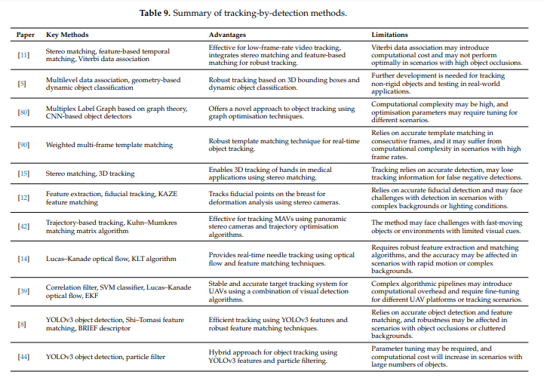

Slide 39
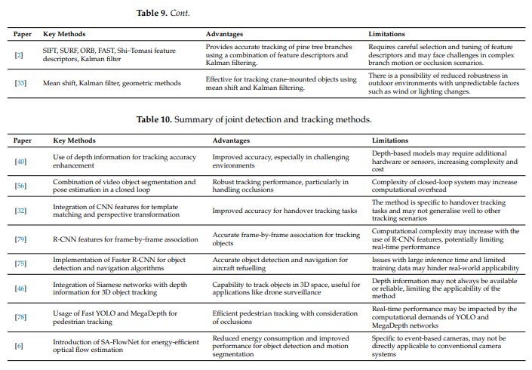

Slide 40
Applications
Medical Applications
Non-intrusive diagnoses using object tracking (e.g., breast conservation surgery, hand-pose tracking for rehabilitation)
Tracking tools like biopsy needles and fiducial points to improve medical procedures
Key Benefit - Enhances precision in surgeries and diagnostics.
Autonomous Vehicles
Detecting cars, pedestrians, and objects for self-driving cars and drones
Uses sensors (radar, GPS, IMU) to predict trajectories and ensure safe navigation
Key Benefit - Safer autonomous navigation for ground, water, and aerial vehicles.

Slide 41
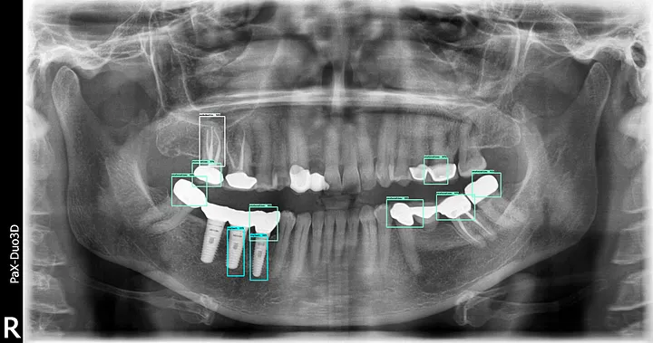
Medical Applications - on dental x -rays with Fast RCNN and SSD
https://medium.com/@clemkoa/deep-learning-object-detection-on-dental-x-rays-8211e48e520b

Slide 42
Surveillance
Tracking human movement and actions in security and sports
Pose estimation and multiple object tracking (MOT) with solutions for occlusion problems
Key Benefit - Enhances human activity monitoring in crowded scenes.
Robotics
Object tracking for safe navigation in autonomous mobile robots
Used in dynamic environments (e.g., forestry, industrial settings) to track moving objects
Key Benefit - Safe and efficient operation in environments that are hazardous or difficult for humans.
Agriculture
Monitoring plant movement (e.g., tree branches swaying in the wind)
Tracking fish underwater for sustainable fishing techniques
Key Benefit - Improves data collection for breeding, disease monitoring, and resource efficiency

Slide 43
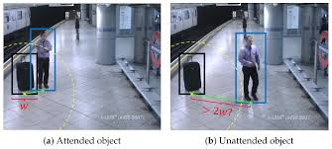
Surveillance - unattended object detection in public places
https://www.mdpi.com/1424-8220/18/12/4290

Slide 44
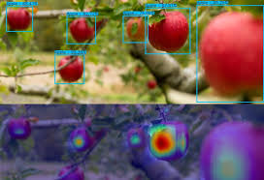
Agriculture - generate predictions about growth rate and yield.
https://avinton.com/en/ai-object-detection/

Slide 45
Space Applications
Tracking space debris to prevent damage to satellites and space stations
Enables unmanned missions to clean space debris
Key Benefit - Ensures safer space travel and satellite operations.
Defence Applications
Missile tracking and interception systems using object detection
Autonomous aerial refueling for aircraft using monocular camera systems
Key Benefit - Enhances precision in defense operations and aerial refueling.

Slide 46
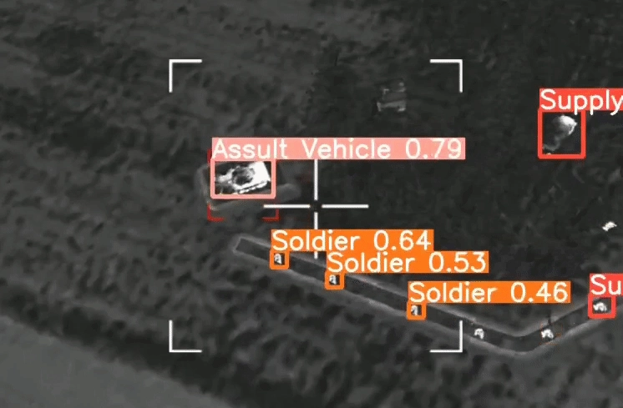
Defence Applications
https://acrome.net/post/ai-robotics-case-open-source-ai-object-tracking-with-smd

Slide 47
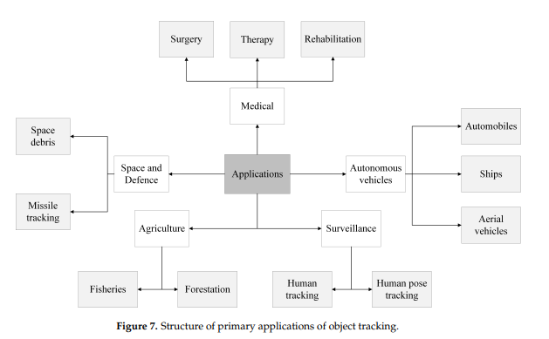

Slide 48
Challenges
Real-Time Tracking - Many methods rely on post-processing of entire video sequences, limiting their application in real-time systems.
Eg. In autonomous driving, tracking pedestrians and vehicles in real time remains challenging, especially in busy cityscapes where environmental factors like lighting and occlusion affect detection accuracy
.

Slide 49
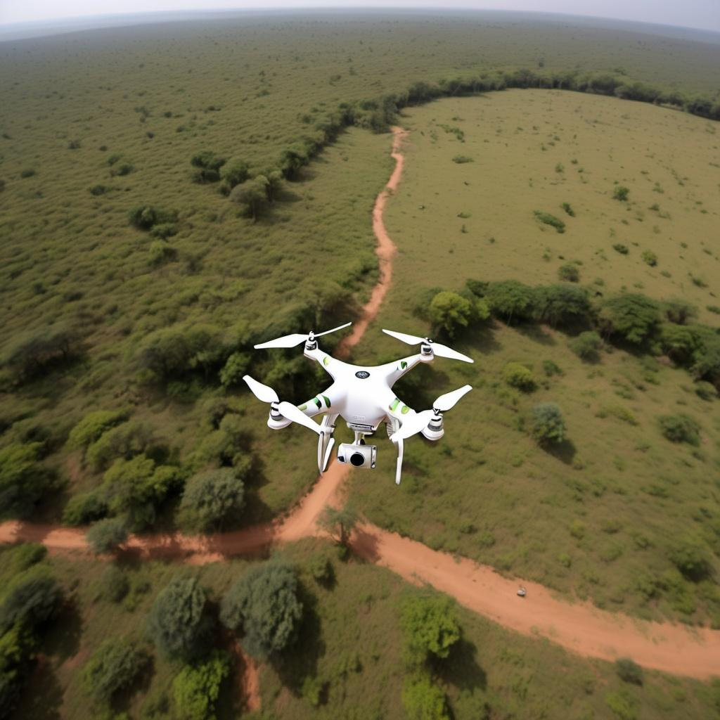
Challenges ctd..
Long-Range 3D Tracking - Current systems have limitations in tracking distant objects (e.g., aerial vehicles), with depth estimation becoming challenging at long distances.
Eg. Drones used in wildlife conservation struggle with tracking
animals from long distances. Current tracking systems
max out at around 80 meters, limiting their ability to
monitor species effectively

Slide 50
Challenges ctd..
Handling Dynamic Environments - Object tracking in adaptive systems, such as robotics, struggles with predicting the movement of objects in dynamic environments
Industrial robots working alongside human workers must predict and avoid collisions in real time, a challenge when the robots are exposed to unexpected movements

Slide 51
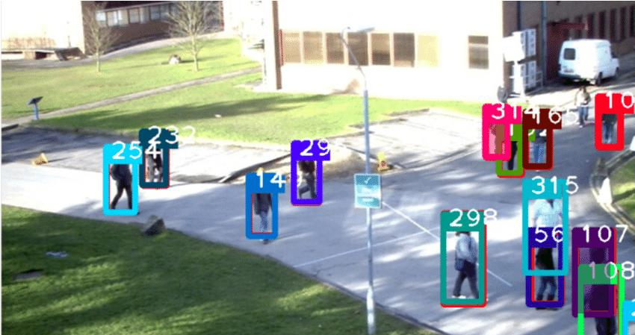
Challenges ctd..
Dataset Limitations - Most existing datasets are tailored to specific applications, lacking generalization for diverse use cases.
Eg. The MOT (Multiple Object Tracking) dataset, which focuses on pedestrian tracking in urban environments, struggles to be applied to warehouse robots that need to track inventory and moving machinery

Slide 52
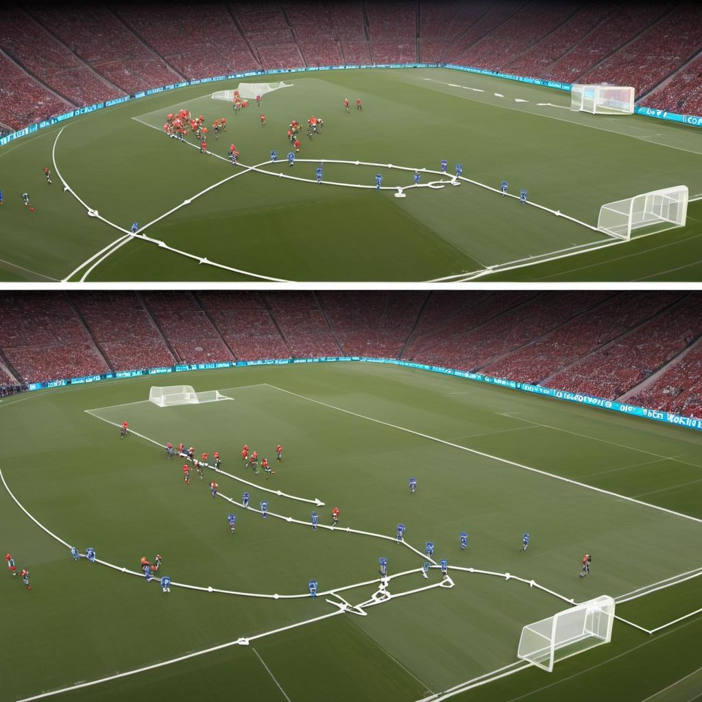
Challenges ctd..
Occlusion and Disappearance - Object tracking methods struggle when objects are temporarily out of view or occluded by other objects.
Eg. In football broadcasts, tracking a player becomes
challenging when they are blocked by other players or
the camera angle changes. The system may lose track
of the player, requiring sophisticated algorithms to
re-identify them once they reappear.

Slide 53
Future Scope
End-to-End Deep Learning: Develop integrated systems for object detection, classification, pose estimation, and tracking in 3D space using a sequence of video frames.
Eg. Surveillance drones could track intruders in real time, detecting their position and estimating future movements using a unified system, improving response time and accuracy

Slide 54
Future Scope ctd..
Extended Range for 3D Tracking: Investigate improvements in camera systems or methods for tracking distant objects.
Eg. Long-range drones used for disaster relief could use advanced panoramic tracking to monitor people from over 100 meters away, aiding rescue efforts.

Slide 55
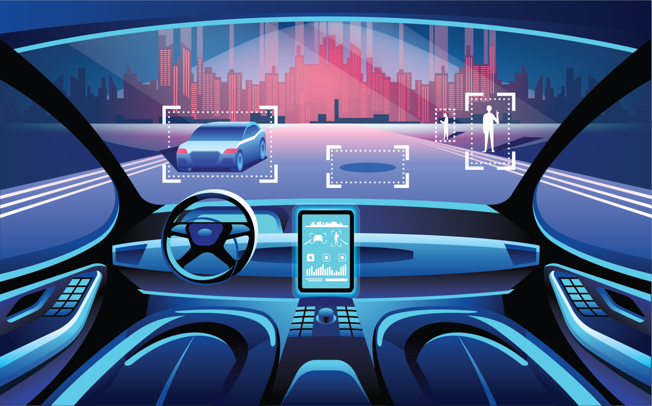
Future Scope ctd..
Predictive Tracking: Incorporate predictive algorithms for real-time object tracking, particularly in dynamic environments, to improve applications like robotics and autonomous vehicles.
Eg. Self-driving cars could predict the movement
of other vehicles or pedestrians, reducing the risk
of accidents by anticipating traffic flow changes.

Slide 56
Future Scope ctd..
Generalized Datasets: Develop broader datasets with stereo camera data, ground truth 3D positions, and object classes for benchmarking across various applications.
Eg. A universal 3D object-tracking dataset could be used to train robots across multiple industries—factories, autonomous vehicles, and aerial surveillance—leading to more versatile solutions

Slide 57
Future Scope ctd..
Optimized Sensor Usage: Investigate the balance between hybrid sensor systems and pure vision-based systems for lightweight applications like drones and robots
Eg. Lightweight delivery drones could use advanced computer vision techniques to track objects and avoid obstacles, reducing the need for heavier, power-consuming sensors like LiDAR, allowing for longer flight times and increased efficiency

Slide 58
References
[1] P. Kadam, G. Fang, and J. J. Zou, "Object Tracking Using Computer Vision: A Review," Computers, vol. 13, no. 6, p. 136, May 2024. DOI: 10.3390/computers13060136.
[2] J. Burkardt, "TIFF file data," [Online]. Available: https://people.math.sc.edu/Burkardt/data/tif/tif.html. [Accessed: Sep. 12, 2024].

